Slide 1
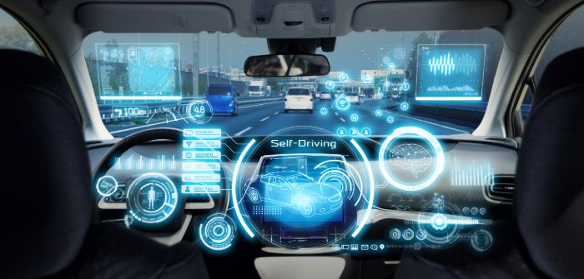
https://youtu.be/FYVVWS5bfZk
ROS Autonomous Vehicles 101
מגישים :
מאור מזרחי 311549968
שגיא כורש 315577569

Slide 2
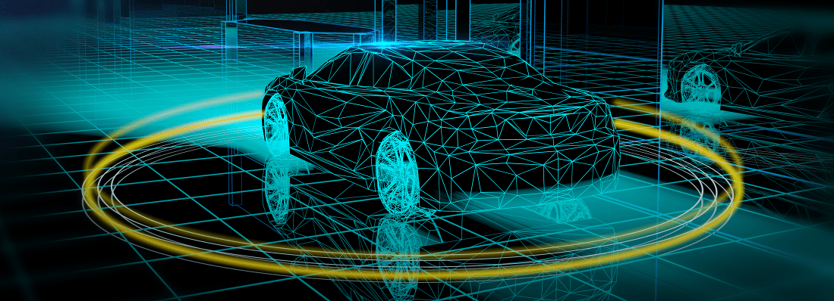
What are we going to present today
Sensors for Autonomous vehicles and the way to access them using ROS.
Autonomous GPS Navigation.
Obstacle-avoider and car security for an autonomous car.
ROS CAN-Bus interface.
Conclusion.
Bibliography .

Slide 3
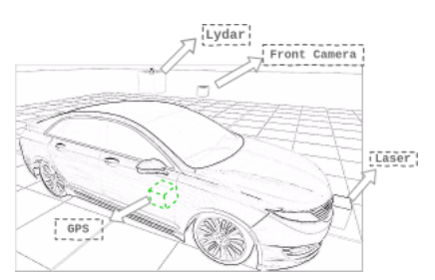
Sensors for Autonomous Vehicles
In autonomous vehicles systems, the most important part are the sensors.
The sensors ensure no human interaction is needed for driving and detecting obstacles in the way. This allow the robot to localize itself in the world around him.
The most basic in crucial sensors needed in order to maintain a safe and working autonomous vehicle’s system are:
Laser
Camera
Lidar
GPS

Slide 4
Laser sensor
In traditional service robots laser sensor are used for navigation. They are used for implementation of SLAM algorithms (Simultaneous localization and mapping ) ,their responsibility is to update and construct a map of an unknown environment.
On the other hand, in autonomous car the approach is different. The use of laser sensors is impractical for mapping outdoor localization.
Thus, lasers are used mainly for obstacle detection.
The laser sensor is the most basic, fast and simple sensor as well as very reliable.
This sensor is the first security measure to avoid obstacle that appear in the way of the vehicle.
When is comes to localization, the GPS give a way better solution (which we will talk abut later).

Slide 5
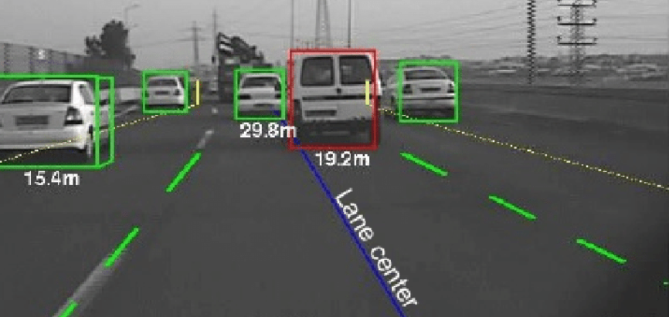
Camera
The next sensor is the camera. It is a very important sensor in autonomous cars because it allows for good identification tool of any objects and people in the way.
Thanks to advanced technologies and coding such as:
Computer-Vision processing
Machine Learning
Convolutional Neural-Networks
We can safely count on the camera to detect with a great presition many of the obsticles and objects in the way.
The most common cameras used for this kind of task is the 360 degree cameras types for getting a full surrounding image.

Slide 6
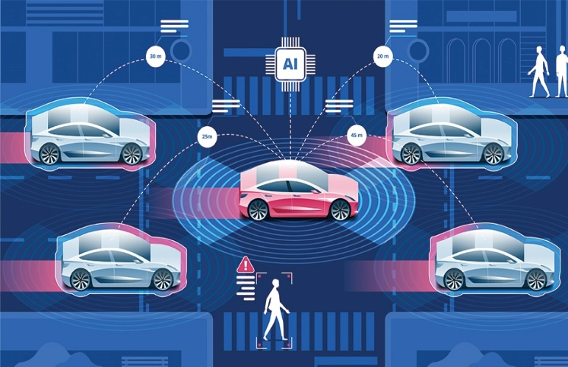
Lidar sensor
The Lidar sensor name stands for “Light Detection And Ranging”.
This Lidar is a remote sensing method that used light in the form of a pulsed laser to measure ranges to earth.
With it we are able to scan roads ,buildings and any abject on the way.
With this sensor we have the ability to generate a “cloud point” (a DB of points) that can be loaded and used for a real world rendering.
The Lidar sensor operation consist scans of the road surface, the computer vision analysis extracting road signalization and create lane objects. Using this we can make a HDMap (High Definition Map) which are a very important need when it comes to autonomous vehicle’s systems.
They must always know in which lane they are located and the route.
Many libraries were developed for this purpose calls “LANENET”.

Slide 7
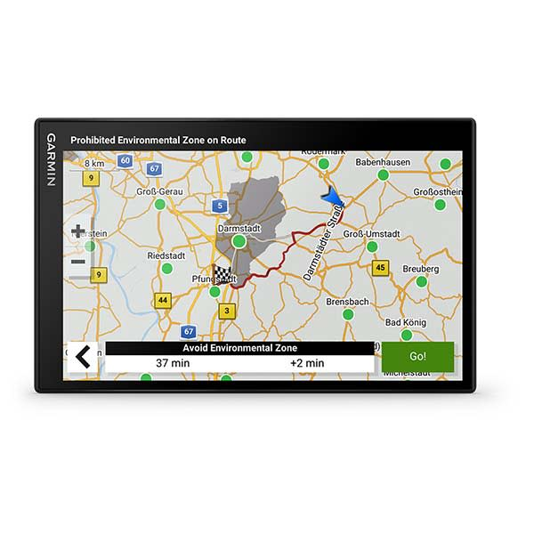
GPS Navigation
The most known sensor used for those kind of system is the “GPS”.
GPS stands for “Global Positioning System”. This kind of technology uses real time geographical data received from several GPS satellites that orbiting the Earth and send data for calculating: longitude, latitude, speed, and a course for the navigation operation.
The GPS provides the system with a peaty accurate set of coordinates of any place on the surface of the earth.
The GPS system considered a “one-way” system, which means that the system that gets the data from it can only receive but cannot send signals to the it.
For achieving it, the GPS gets it signals from 24 satellites in fixed orbits around the earth. Each satellite continuously transmits GPS signals to the earth, which consist of two carrier frequencies: digital codes and navigation message which are used for determining the distance of the satellite from the receiver.
The navigation message consists of information such as satellite location and clock compensation.
The receiver then takes the information given to it and with a set of calculations, it can predict its position on the earth surface, direction and distances in order to aid autonomous navigation.

Slide 8
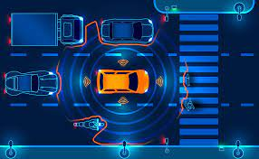
The need of GPS in Autonomous Vehicle
Thanks to the GPS capabilities the end user can determine its exact position with is a very important factor when it comes to autonomous vehicles. Without it, knowing the position on earth could be a very hard task on the verge of impossible using other methods.
By utilizing the information about its position, the vehicle can safely navigate on its own in a static or dynamic environment without any need of human intervention. Also, by that we will achieve a better route planning, path prediction, smoother maneuverability in dynamic environments, optimized fuel efficiency and enhanced human comfort.
The way the GPS works is by using an algorithm that takes in inputs from the GPS receiver and using them to successfully navigate a car through a set of known points and called it as waypoints and thus giving us the benefits discussed before.
The process of a GPS navigation algorithm of the autonomous vehicle is as follow:
1) Setting a start waypoint where the GPS receiver tries to get a fix on visible GPS satellites and compute current location.
2) The algorithm computes the direction of the destination waypoint from the current position.
3) The algorithm steers the car in the direction of the destination point.
4) Repeats those stages after reaching the destination to navigate to next waypoint until reaching the destination.

Slide 9
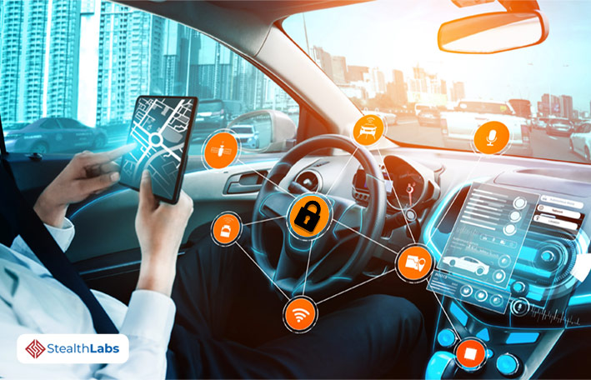
System Security
When is comes to robotics, the security matter have a very high priority in the eye of the ROS developers. For this reason
open Robotics has registered a CVE that affects ROS Kinetic, Melodic and Noetic.
The term CVE stands for “Common Vulnerabilities and Exposures”.
The CVE is an international system that provides a method for publicly sharing information on cybersecurity vulnerabilities and exposures.
Autonomous devices are at higher risk for attackers to reach, not only desktops but also other devices that don’t typically have a physical human operators working on it. There are many kinds of attacks ranging from denial-of-service (DoS) to a full-blown ransomware attack.
The objectives of good security are:
Confidentiality
Only the intended recipients can read data
Hide the contents of messages from unwanted observers
Encryption of data for keeping it safe even in the case of information leak
Integrity
Prevent data from being tampered/modified by a third party
Prevent spoofing/masquerading and the so called ”man in the middle” attacks
Uses iIntegrity checks, hashes
Authenticity
A given entity’s claimed identity can be proven
Uses certificates, digital signatures

Slide 10

CAN-Bus
CAN Bus is a vehicle serial communication bus standard, designed to allow devices and processors to communicate with each other’s applications.
CAN Bus stands for “Controller Area Network”. It consists of two electrical wires called “CAN_Low” and “CAN_High”. The information within each vehicle is being transmitted by an “Electronic Control Unit”.
The CAN communication bus is designed for robust performance within harsh environments, primarily in industrial and automotive applications.
Nodes or electronic control units (called ECUs) are something can be considered as body parts that are interconnected through the CAN bus to make a full body.
Some of the benefits of the CAN-Bus are:
Low-cost, Speed, Flexibility: well-known and can add and remove nodes easily, its Efficiency and one of the best advantages of CAN - reduced amount of wiring in combination with an ingenious prevention of message collision.

Slide 11

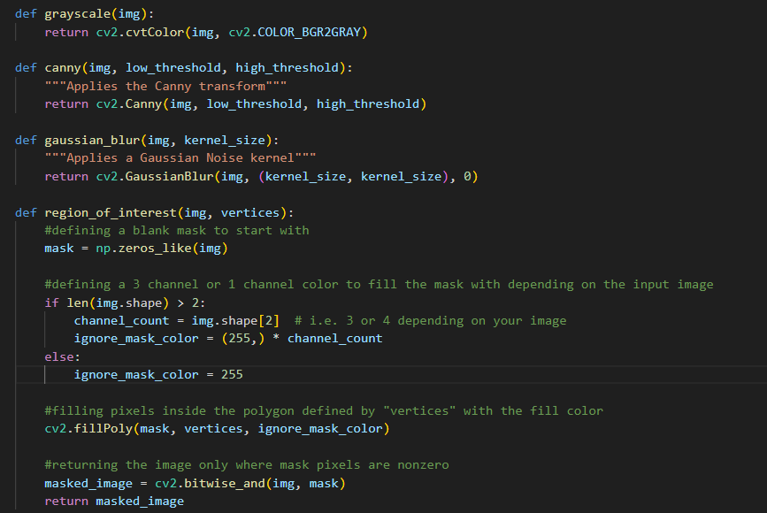
Code

Slide 12
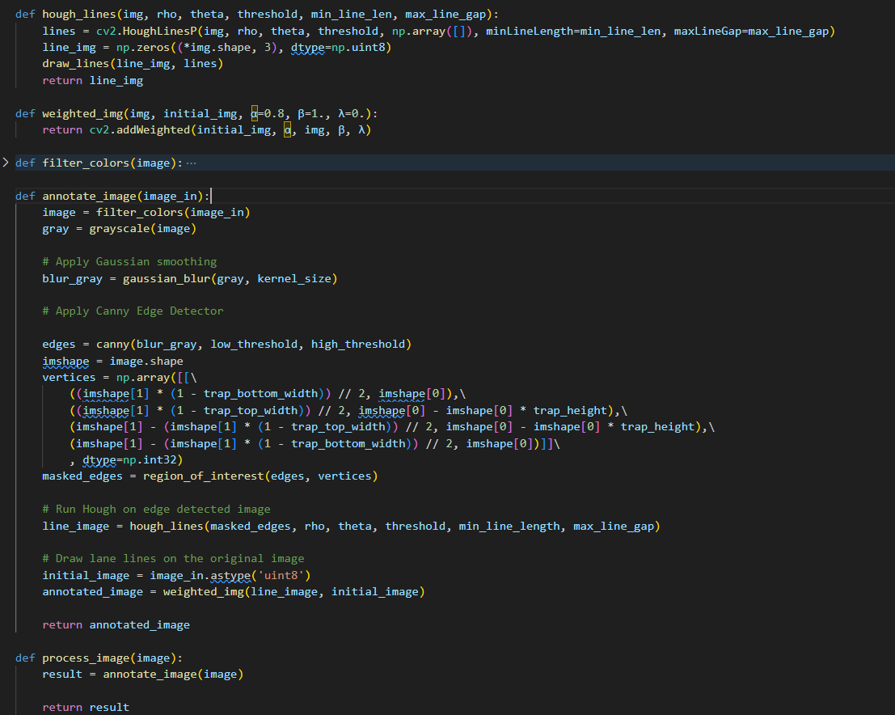
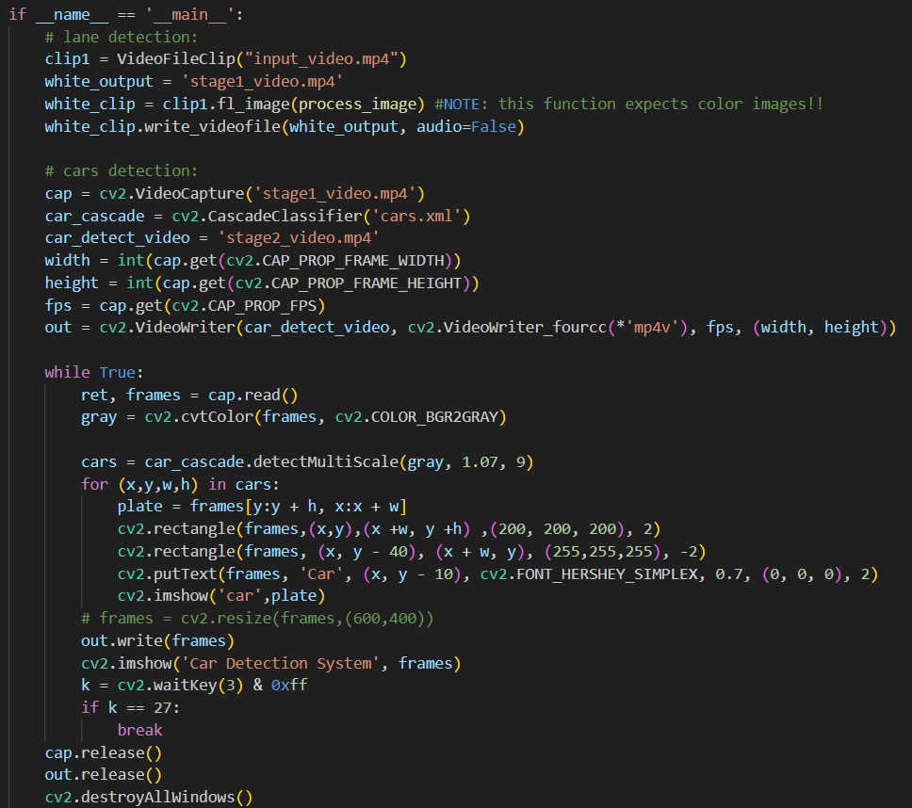
Code

Slide 13
Conclusion
As for today, it seems like the autonomous vehicle will have a big impact on the future of how we live and navigate around.
While the future might seem a lot better thank to what those technologies can offer us, there are some very important considerations such as safety and comfort of the future users that we have to consider.
Before going all out, the safety, security and quality of the mechanisms must be taken into consideration. The sooner we find problems the better and easier it will be for us to fix it to make it more reliable.
In addition, with the ever growing technology, cyber protection needed to be maintained periodically so that our vehicles will be protected from attacks.

Slide 14
Bibliography
https://app.theconstructsim.com/en/course/linux-robotics/details/#/Course/7
https://en.wikipedia.org
https://resources.system-analysis.cadence.com/blog/msa2022-the-use-of-radar-technology-in-autonomous-vehicles
https://www.nhtsa.gov/technology-innovation/automated-vehicles-safety
https://ubuntu.com/blog/ros-cve-alert-ensuring-security-for-robotics
https://www.azom.com/article.aspx?ArticleID=16424
https://www.udacity.com/blog/2021/03/how-self-driving-cars-work-sensor-systems.html
https://www.automotiveworld.com/articles/lidars-for-self-driving-vehicles-a-technological-arms-race/

Slide 15
GITHUB
https://github.com/maormizrahi2/Automatic_Vehicle_Course

